Slide 1


Devops
By Sachin
Fusion Corporate Training Center, Pune

Slide 2

Git And Github
Git Is Source code Management tool: Source code management (SCM) is used to track modifications to a source code repository.
It is a free and open-source version control system used to handle small to very large projects efficiently.
Source code management (SCM) is the process of tracking modifications and managing changes to source code. SCM allows developers and other stakeholders to see a complete history of all changes made to a shared codebase.
This ensures developers are working with up-to-date code and that there are no conflicting code changes.
Every Development teams needs a good way to Manage changes and Version Code in their Codebases.
SCM Refers help that you keep track of your code with Complete history of changes

Slide 3

Benefits Of Source Code Management:
SCM has started tracking all the changes to a project over time, a detailed historical record of the projects life is created. This historical record can then be used to ‘undo’ changes to the codebase
The SCM can instantly revert the codebase back to a previous point in time.
When multiple developers are working within a shared codebase it is a common occurrence to make edits to a shared piece of code.
With SCM developers can work independently on separate branches of feature development, eventually merging them together
Separate developers may be working on a seemingly isolated feature, however this feature may use a shared code module.
Source code management helps you and your team to work quickly and collaborate efficiently within your DevOps workflow

Slide 4

VERSION CONTROL SYSTEM (VCS)
Version control is a system that records changes to a file or set of files over time so that you can recall specific versions later.
It allows you to revert selected files back to a previous state, revert the entire project back to a previous state, compare changes over time, see who last modified something that might be causing a problem, who introduced an issue and when, and more.
Using a VCS also generally means that if you screw things up or lose files, you can easily recover.
Here version control is also called as source control its one and the same thing. SCM or VCM is one and the same

Slide 5
TYPES OF VERSION CONTROL SYSTEM (VCS)
Version control systems are tools that help a software team manage changes to source code over time.
Local VCS
Centralized VCS
Distributed VCS

Slide 6

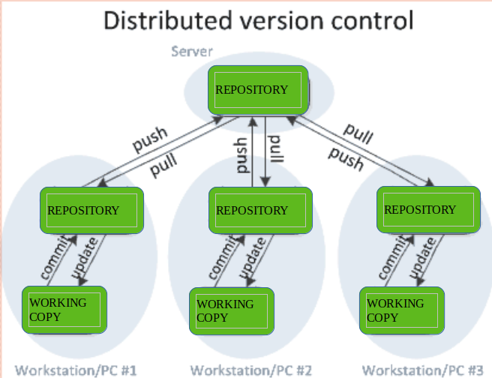
DISTRIBUTED VERSION CONTROL SYSTEM
Distributed version control systems contain multiple repositories. Each user has their own repository and working copy.
The most popular distributed version control systems are Git

Slide 7

Git
Git : Software / Tool
Github : Service
Gitlab : Service Central Repo

Slide 8
Why git is importatnt
The StackOverflow Developer survey results shown below show that 93% of engineers use Git and it is a fundamental tool for them.
Git tracks the changes you make to files, so you have a record of what has been done, and you can revert to specific versions should you ever need to.

Slide 9


Slide 10
Role of GIT in DevOps
The DevOps approach needs a version control system that will track all the changes. Git is a distributed version control system that allows developers to keep a local copy of the commits they make. GIT as a DevOps tool empowers collaboration and faster release cycles, and that is what the DevOps concept is based upon.
Version control is one of the best practices of DevOps. With version control, developers working on a project can version the software, share, collaborate, merge, and have backups.

Slide 11
Role of GIT in DevOps
When working in large organizations, where multiple teams work together on the same project, Git comes in handy and makes it easy to track changes made by each team. It helps in tracking code, version control, and effective management of code.

Slide 12
Workflow of git
Working Directory / workspace:
Where you see file physically and do modification. At a time you can work on particular branch
Git looks for the files present in the staging area only those files present in the staging area are considered for
Commit and not all the modified files.
Add Commit
Push
Github
Working Directory
Staging Area
Local Repository
Central Repo

Slide 13
Workflow of git
Commit—stores the current contents of the index in a new commit along with a log message from the user describing the changes
Store the changes in Repository. You will get one commit –ID
Git push: It is used to upload local repository content to a remote repository. Pushing is an act of transfer commits from your local repository to a remote repo.

Slide 14
Workflow of git
Git status : The status command is used to display the state of the working directory and the staging area. It allows you to see which changes have been staged. It also lists the files that you've changed and those you still need to add or commit.
Git log : used to check the commit history.
Git remote : Git Remote command is used to connect your local repository to the remote server. This command allows you to create, view, and delete connections to other repositories.

Slide 15
Workflow of git
Repository : In many ways, you can think of a Git repository as a directory that stores all the files, folders, and content needed for your project. What it actually is, is the object database of the project, storing everything from the files themselves, to the versions of those files, commits, deletions, et cetera. Repositories are not limited by user, and can be shared and copied.
Changes are Personal to that Particular Repo
Servers : It Stores All Repositories, It contain Metadata Also.

Slide 16
Workflow of git
Git config : This command configures the user. The Git config command is the first and necessary command used on the Git command line. This command sets the author name and email address to be used with your commits.
Git clone : This command is used to make a copy of a repository from an existing URL. If I want a local copy of my repository from GitHub, this command allows creating a local copy of that repository on your local directory from the repository URL. copy of that repo at in a new directory, at another location. The original repository can be located on the local filesystem or on remote machine accessible supported protocols. The git clone command copies an existing Git repository.
Git Fork : When you fork a repository, you create a copy of the original repository but the repository remains on your GitHub account.
Git pull : Pull command is used to receive data from GitHub. It fetches and merges changes on the remote server to your Local Machine. Pull operation Is used for Synchronization between two repo.

Slide 17
Workflow of git
Git Tags : Tags Assign a meaningful Name with A specific version in the repository. Once Tag is created for a particular save , even if you create a new commit, it will not be updated
Git Branch : You can take advantage of branching when working on new features or bug fixes because it isolates your work from that of other team members. A git branch is an independent line of development taken from the same source code.
A Git project can have more than one branch. These branches are a pointer to a snapshot of your changes. When you want to add a new feature or fix a bug, you spawn a new branch to summarize your changes.
Each task has one separate branch , usefull when you want to work parallaly,
File created in workspace will be visible in any of the branch, workspace until you commit once you commit , then that file belongs to that particular branch
Default Branch Is Master/main, when created new branch data of existing branch is copied to new branch

Slide 18
Workflow of git
Easier Branching : If you create a new branch , it will copy all the data to the new branch, when you created new branch, data of existing branch is copied to new branch
Branching Strategy In Organization: we maintain our source code in master/main branch, every release we create seprate branch, where developer checking and last they merge with master branch.
Merge : git merge is used to combine two branches, Taking the changes from one branch and adding them into another branch.
When same file having different content in different branches, if you do merge, conflict occurs (Resolve conflict then add and commit). Conflict occurs when you merge branches

Slide 19
Workflow of git
Git Reset : git reset is a powerful command that is used to undo local changes to the state of a Git repo. To reset the changes from both staging area and working directory at a time.
Git Revert: Git revert is used after commit , when you push local repo then we can revert to previous change.
In Git, the term revert is used to revert some changes. The git revert command is used to apply revert operation. It is an undo type command. However, it is not a traditional undo alternative. It does not delete any data in this process; instead, it will create a new change with the opposite effect and thereby undo the specified commit. Generally, git revert is a commit.

Slide 20
Workflow of git

Slide 21
Workflow of git

